Slide 1
Milestone 4
WKU themed wikipedia

Slide 2
introduction
Project objectives and goals
Finalized Requirements
The group’s approach
Progress visibility
Technical Resources
Models of project components
Approach to security issues
Approach to performance issues
Approach to HCI
Approach to static/dynamic testing
Final thoughts
PROJECT MEMBERS:
Michelle Schapmire
Daniel Monterrosas
Zachary Wathen
Peter Harlan
Steven Booth
CLIENT: Mahn DO

Slide 3
Project overview and goals
PROJECT OBJECTIVE:
Create a smaller version of Wikipedia centered around Western Kentucky University that meets the requirements of our client.
TARGET USERS:
WKU students, faculty staff
Possible future students
PROJECT GOALS:
Search for articles
Create articles
Edit articles
User registration
User account levels (Missed Goal)

Slide 4
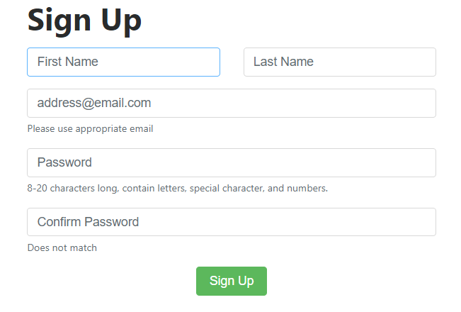
Functional requirement: account creation

Slide 5

Functional requirement: login and search

Slide 6
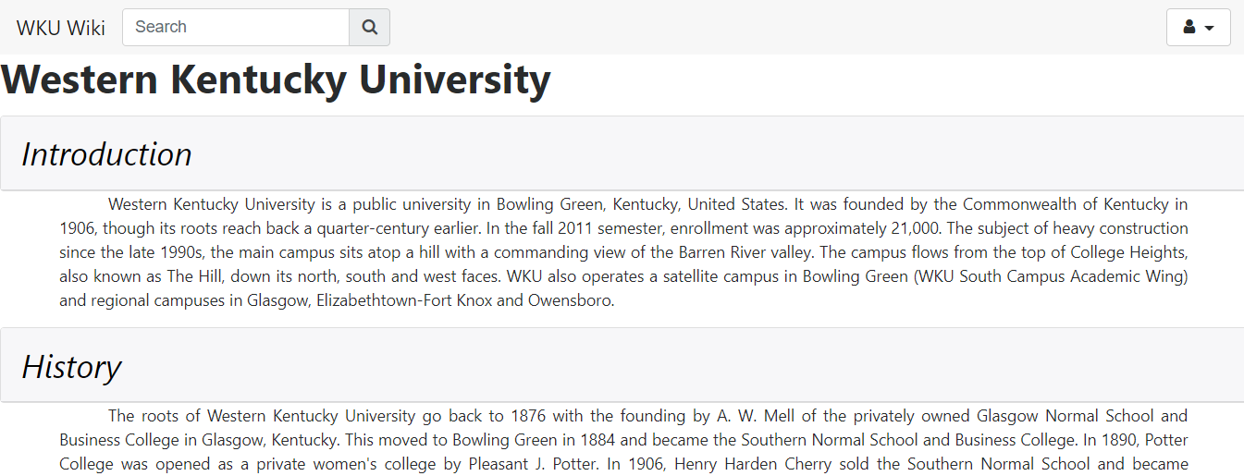
Functional requirement: view an article

Slide 7
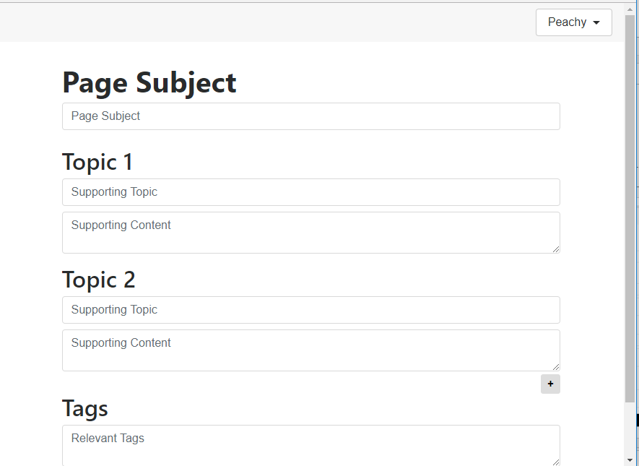
Functional requirements: Create an article

Slide 8
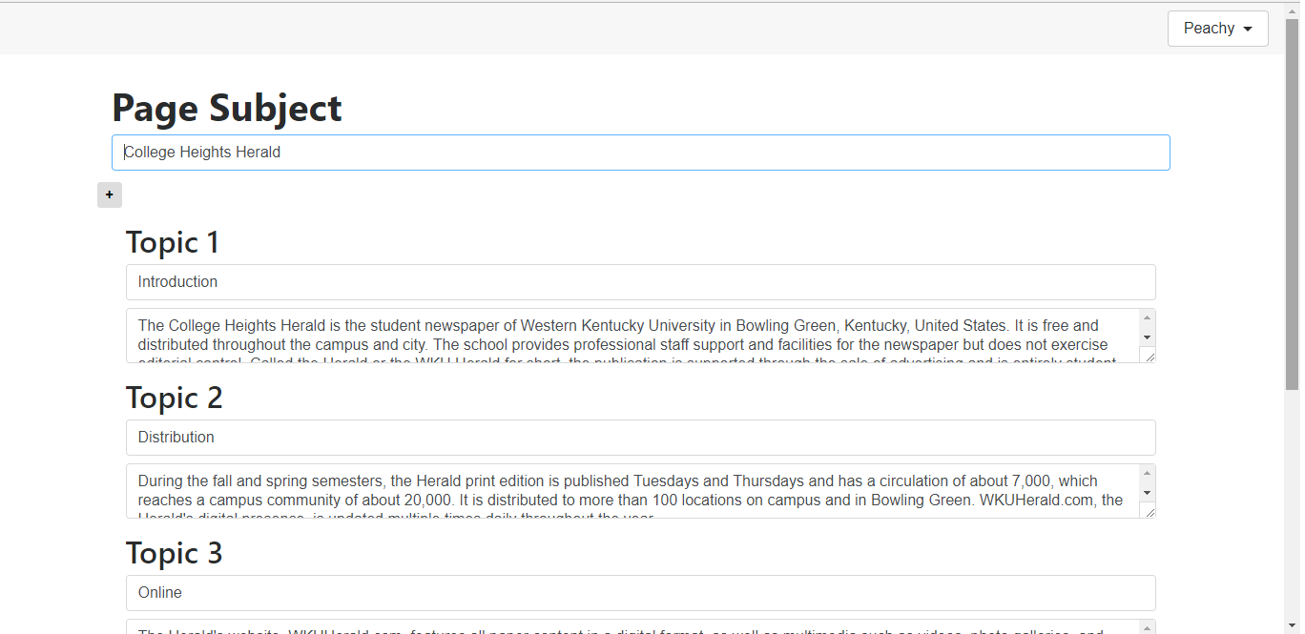
Functional requirement: edit page

Slide 9
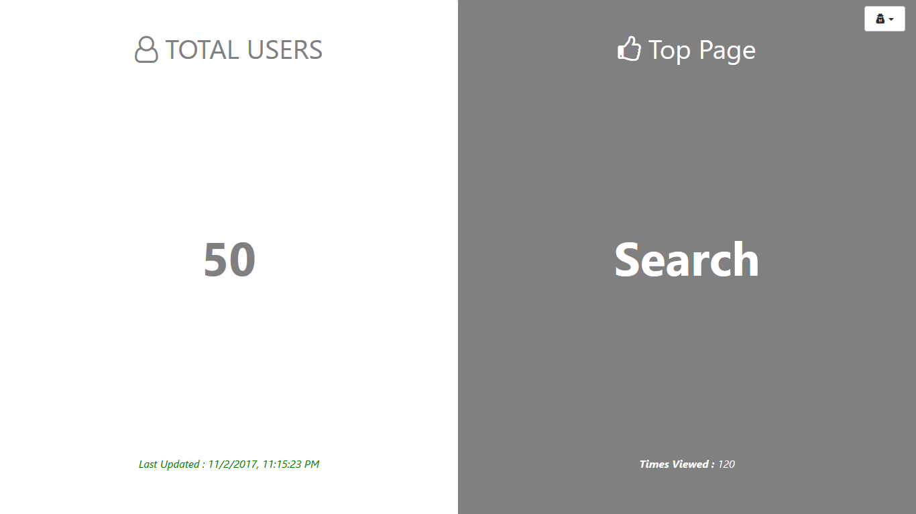
Functional requirement: performance monitor

Slide 10
Non-functional requirements
Compatibility – The website’s interface will be responsive devices of varied sizes and will work on any system with internet connection.
Maintainability – Our system will be, for the most part, maintained by the users as the users themselves will be able to create and add information to the system.
Usability – The website’s interface will be easy to navigate on first use by the user. They should not require a tutorial.
RELIABILITY
Probablility of failure on demand
Rate of occurrence of failure
Mean time between failures
Mean time to repair
Availability
Overall reliability

Slide 11
The group’s approach: Meeting and communication
Meeting Time | Meeting Type | Subgroup Meeting | Team Meeting
Monday 6-8:30pm | In Person/Virtual | Yes | No
Tuesday 4-7:00pm | In Person | No | Yes
Thursday 6-8:30pm | In Person/Virtual | Yes | No
Thursday 8:30-9pm | Virtual | No | Yes
Friday 11:30-12:25pm | In Person/Client Meeting | No | Yes

Slide 12
The group’s approach: iterative software process

Slide 13
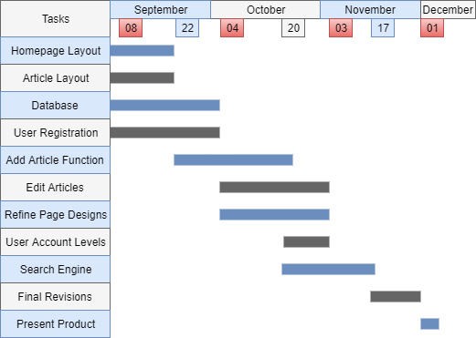
The group’s approach: milestone 1 initial plan

Slide 17
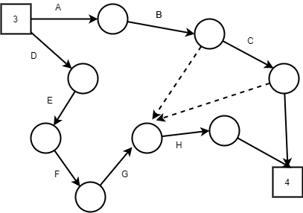
The group’s approach: final activity graph

Slide 18
Task Label | Description | Personnel | Required Resources | Task Dependency | Hours Est.
A | Design the search function | Zach, Peter, Michelle |  |  | 3
B | Implement the search function | Zach, Peter | Apache, Mysql, PHP, Bootstrap | A | 8
C | Implement the edit page function | Zach | Apache, Mysql, PHP, Bootstrap |  | 4
D | Define reliability requirements | Daniel, Steven |  |  | 2
E | Create software tests | Daniel, Steven |  |  | 3
F | Create final report draft | Everyone |  | D, E | 4
G | Run software tests | Daniel, Steven |  | B, C | 7
H | Create final report and presentation | Everyone |  |  | 5

Slide 19
The group’s approach: total time spent on project
Estimated total time spent
Calculation
Over 218 hours
128 hours from activity chart totals
50 hours estimated for milestone 1
40 hours for unexpected delays

Slide 20
The group’s approach: difficulties and solutions
Hardware Failure
Router didn't allow us to connect to pi remotely
Pi resetting
SD card Corruption
Time management (busy schedules)
Lack of Experience

Slide 21
Progress visibility
Task Name | Start Date | End Date | Duration (Days) | Days Complete | Days Remaining | Percent Complete
Design search function | 11/4 | 11/9 | 5 | 5.00 | 0.00 | 100%
Implement search function | 11/9 | 11/20 | 11 | 15.00 | -4.00 | 100%
Implement edit page | 11/16 | 11/20 | 4 | 10.00 | -6.00 | 100%
Define reliability requirements | 11/4 | 11/11 | 7 | 7.00 | 0.00 | 100%
Create software tests | 11/4 | 11/11 | 7 | 7.00 | 0.00 | 100%
Create milestone 4 rough draft | 11/12 | 11/17 | 5 | 5.00 | 0.00 | 100%
Run software tests | 11/12 | 11/22 | 10 | 10.00 | 0.00 | 100%
Makes changes and fixes to software | 11/22 | 11/28 | 6 | 6.00 | 0.00 | 100%
Create final report | 11/22 | 11/30 | 8 | 8.00 | 0.00 | 100%
Create presentation for client | 11/27 | 11/29 | 2 | 2.00 | 0.00 | 100%
Deliver report and presentation to client | 12/1 | 12/2 | 1 | 1.00 | 0.00 | 100%

Slide 22
Technical resources: hardware architecture
Raspberry pi 3
HDMI Port
Built in WIFI
Ethernet
Audio Jack
SD card port
Micro USB Power
USB ports
Quad Core Processor

Slide 23
Technical resources: software architecture
Linux
Apache
MySQL
PHP
Bootstrap
Github
Phpmyadmin
Docker
Docker Cloud

Slide 24
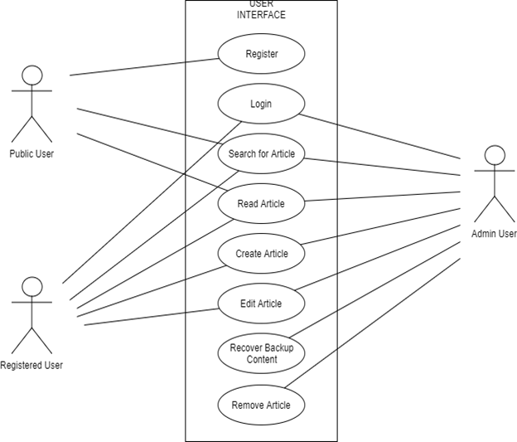
Use case diagram

Slide 25
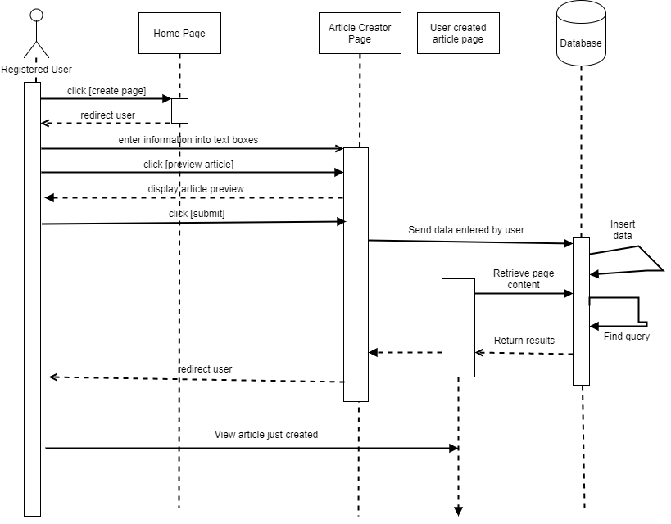
Sequence diagram

Slide 26
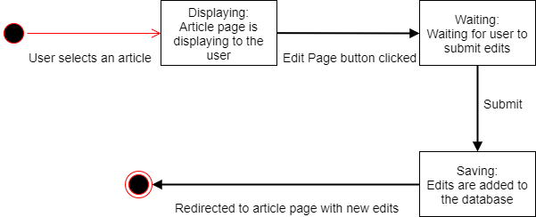
State diagram

Slide 27
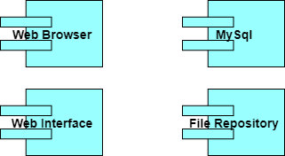
Component diagram

Slide 28
Deployment diagram

Slide 29
Security issues: security requirements
Identification – Upon Login. Authentication – During Login based on email and security questions. Authorization – 3 types of users with 3 levels of authorization: non-registered, registered, and admin level users. Immunity – Anti-virus software. Integrity – Frequent and organized backups. Intrusion – Network-based intrusion detection system (NIDS). Privacy – Passwords hashed and stored as hash, no one can see true password.

Slide 30
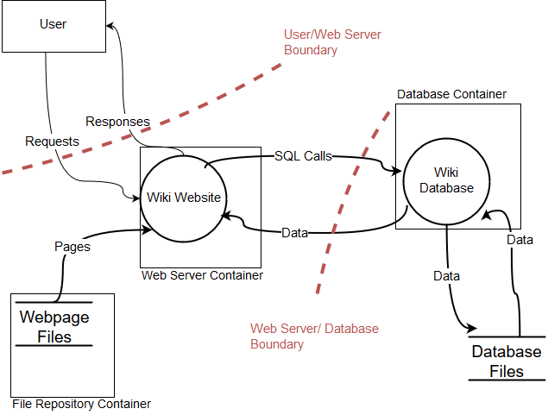
Security issues: security threat models

Slide 31
Security issues: mitigating security threats
SQL Injections
Prepared SQL statements
Buffer Overflows
Bounds checking on server-side (php)
Restrict input length on web-side (html)
Cross Site Scripting
Input validation
Output sanitation and escaping

Slide 32
Performance issues: performance requirements
Component | Performance Objective
Database | Handle 200 transactions per second
File I/O | Process 5,000 kb/sec
CPU | Execute 10,000 events under 300 seconds
Network | Ping under 100ms

Slide 35
Average Execution Rate (Kb/s) File I/O

Slide 36
Average Total Time CPU 15K Prime

Slide 37
Database Transactions 1M Table

Slide 38
Hardware bottlenecks
Subsystem Type | Hardware | Performance Expectations
CPU | 4x ARM Cortex-A53 | Minimum speed 700MHz
 |  | Maximum speed 1.2GHz
 |  | L1 Cache 8-64KiB
 |  | L2 Cache 128KiB-2MiB
Network | BCM43438 wireless "combo" chip | Dual-band 2.4 GHz and 5 GHz IEEE 802
File I/O | 1GB LPDDR2 | Internal Access Rate 200MHz
 |  | I/O Bus Clock Frequency 400MHz
 |  | Data Transfer Rate 800MT/s

Slide 39
Software bottlenecks
Hot spots- sections of code that execute most frequently.
Search function
Search function will slow down significantly as the size the article table in the database increases
Utilized tags to make searching related articles easier

Slide 40
user interface requirements
Simple interactions
Access anything within 2-3 clicks
Mobile ready

Slide 41
updating the user interface
Look: Characteristics of appearance
Scale: 9
Comment: Needs to improve CSS to design text
Feel: Interaction technique that provides satisfactory experience
Scale: 9
Comment: It looks good, easy to read and get into
Navigation: Ease of moving around the system
Scale: 10
Comment: no comment
Conventions: familiar aspect of webpage based on previous experiences
Scale: 9
Comment: Good feature when applying login functions without changing pages. Need to check to make sure that the email input is valid by checking for "@" and ".com". Also need to improve the quality of password requirement such as: have one-digit, upper caser, special symbol... or has at least 6 characters and numbers.

Slide 42
Static testing
Data Dictionary
Name | Type | Where Used | Description
$loginSuccessful | Boolean | login.php | Returns true if login succeeds
$accountLevel | Integer | login.php + | Variable that holds account level (0,1,2)
$name | String | login.php + | String representing username
$userID | Integer | login.php + | The hidden ID of a user
$password | String | login.php + | String holding temp password to pass & check
$accExists | Boolean | login.php + | Returns true of the account exists
$email | String | register.php | String that holds email address
$fname | String | register.php | String that holds first name of user
$lname | String | register.php | String that holds last name of user
Pair design
Code Reviews

Slide 43
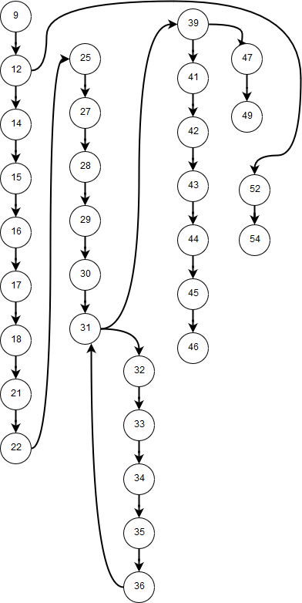
Dynamic testing
Path Testing

Slide 44
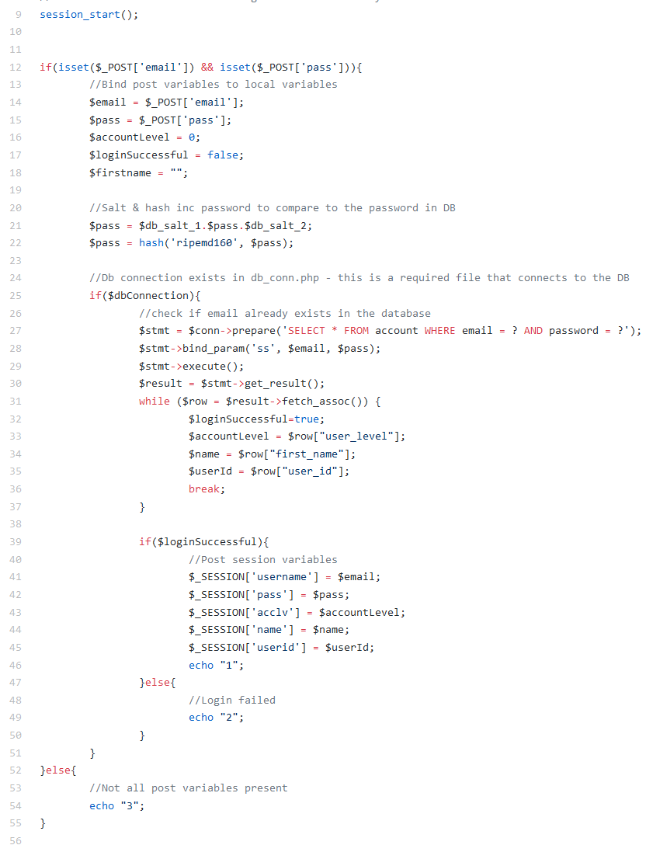

Slide 45
Final thoughts: what did we learn
Programming requires teamwork
Thinks will always take longer than projected – Mystical Man
Addressing the request of the client is top priority
Test, test, test.... wait for it... more test
Notes:
You just doing this bare minimum stuff for the rest?

Slide 46
Final thoughts: what would we do differently
Code in pairs – in the end, Zach was the only person able to code back end
Create back ups of all files and databases
Longer time estimates of task completion

Slide 47
Conclusion and potential future works
Pill Buttons on the homepage does not have functionality
Allow users to delete certain sections from their article with a minus button
Admin tier account level
Allow users to access archives of previous version
Captcha
Account recovery function

Slide 48
demo
Lower your expectations and you will always be surprised!

